Slide 1
Lesson 6
American History
C: Recent American History & Other Important Historical Information
Section: International Wars
Questions: 72, 78, 79, 80, 81, 82, 83, 86

Slide 2
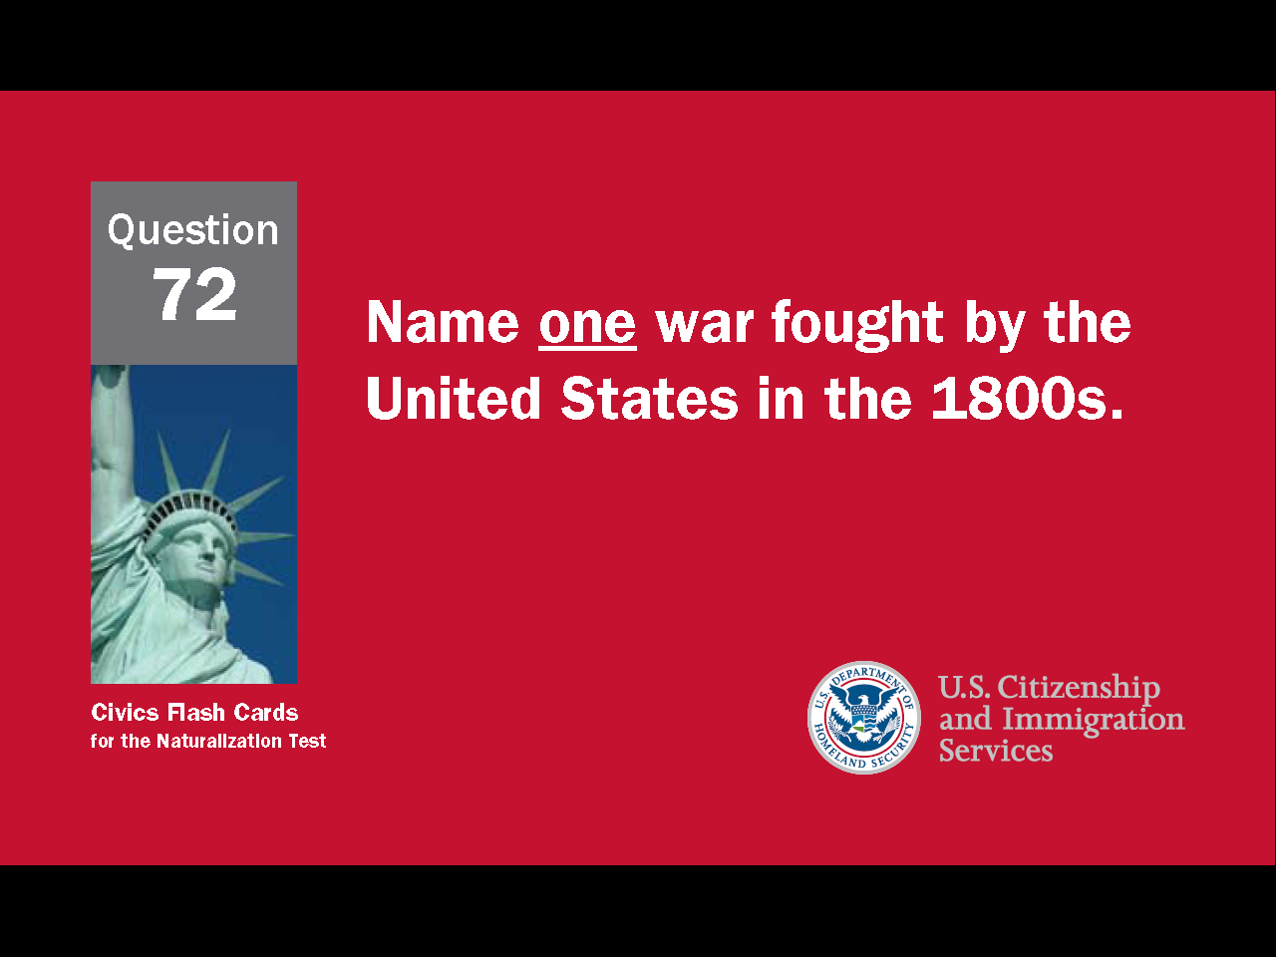

Slide 3
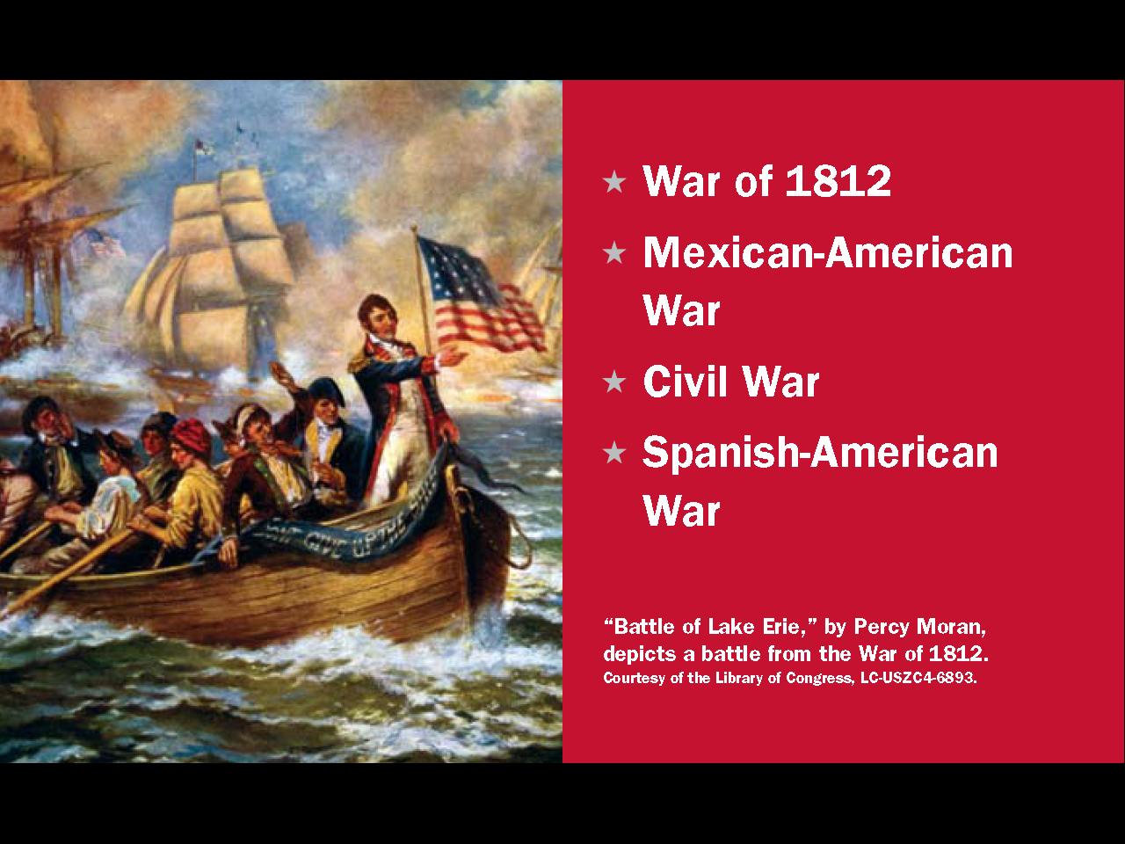
Question # 72

Slide 4


Slide 5
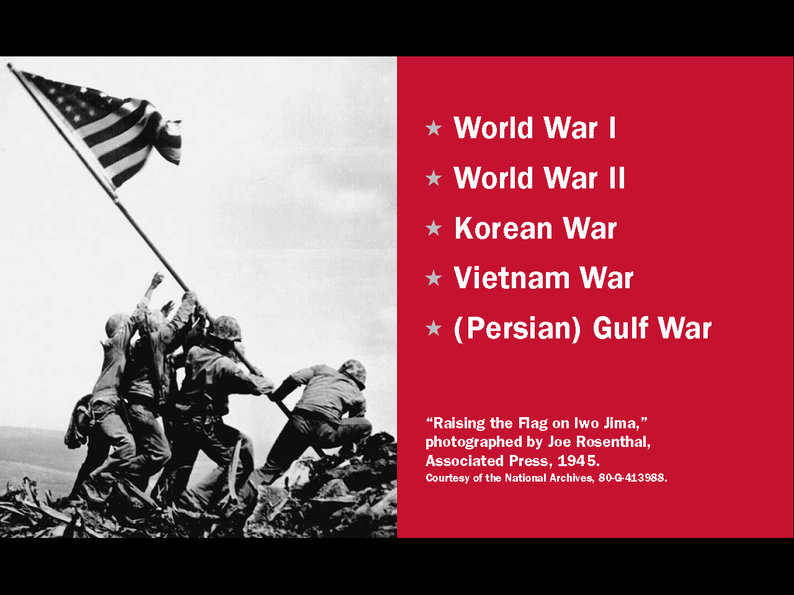
Question # 78

Slide 6
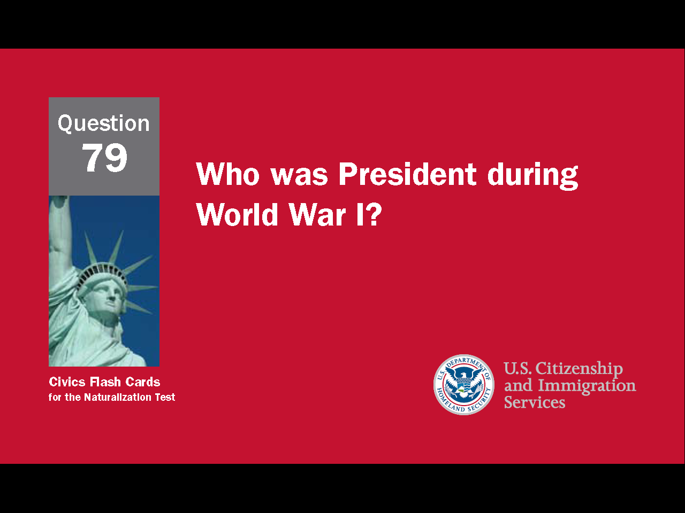

Slide 7
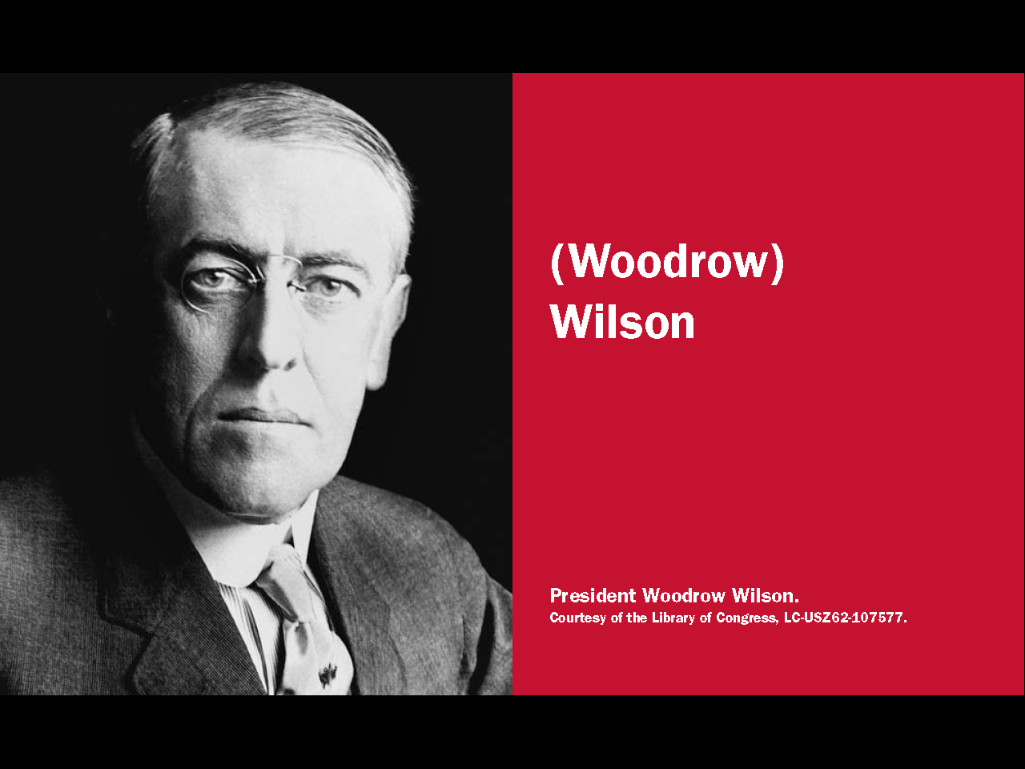
Question # 79

Slide 8
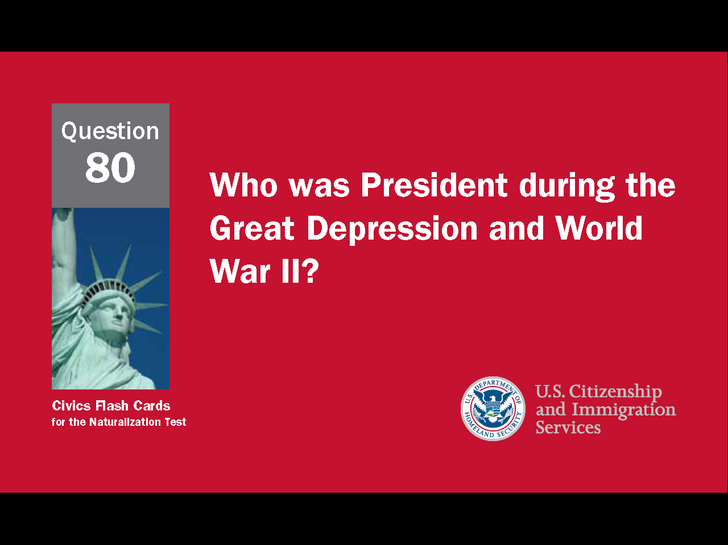

Slide 9
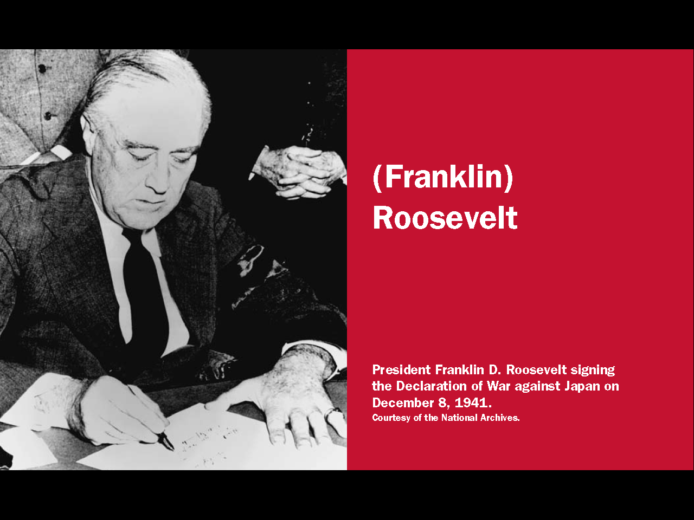
Question # 80

Slide 10
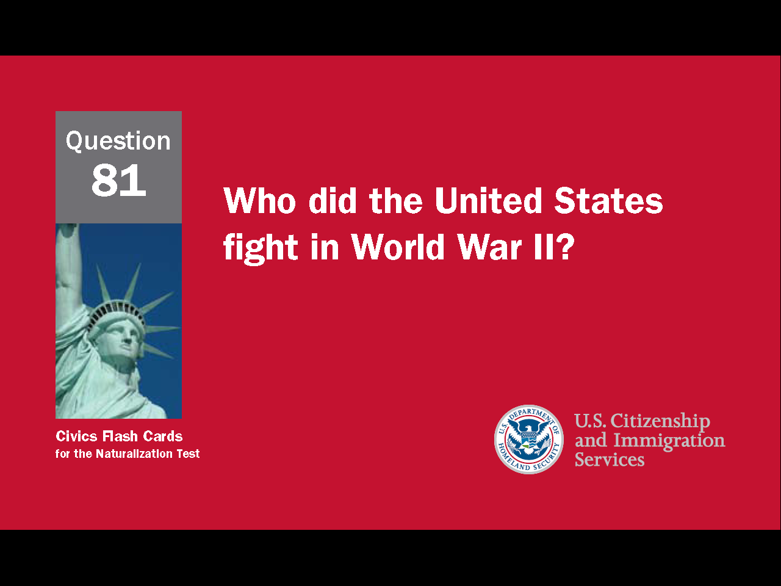

Slide 11
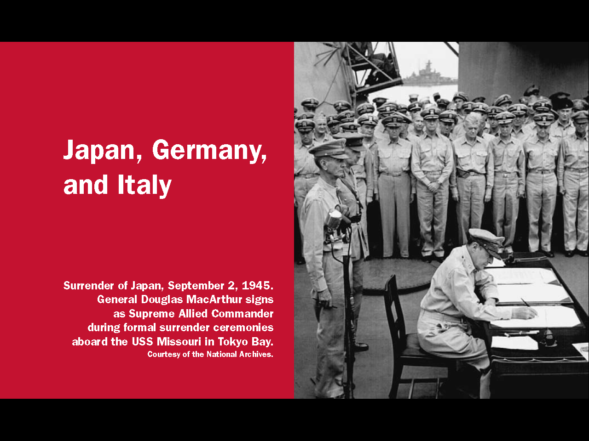
Question # 81

Slide 12
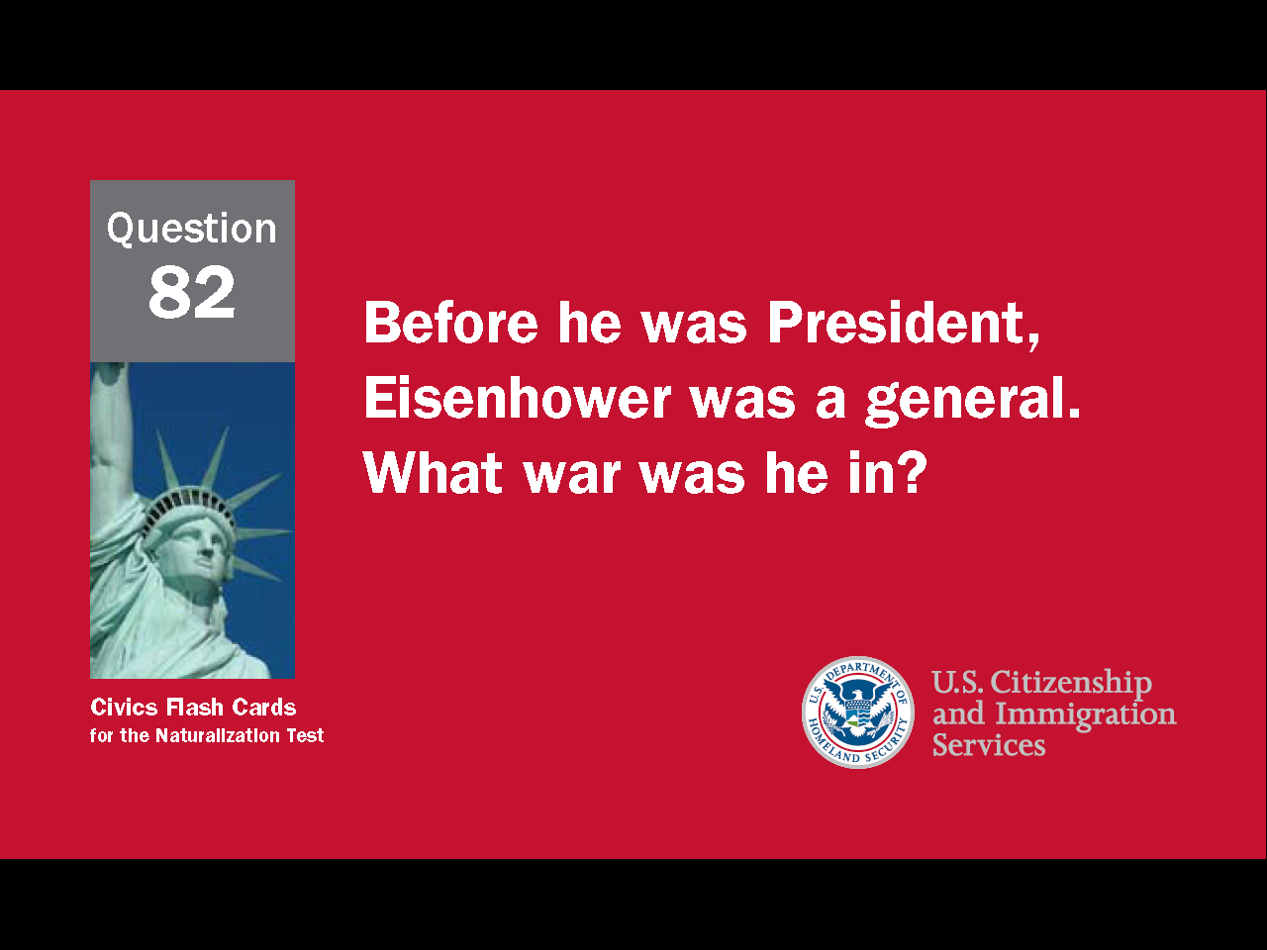

Slide 13
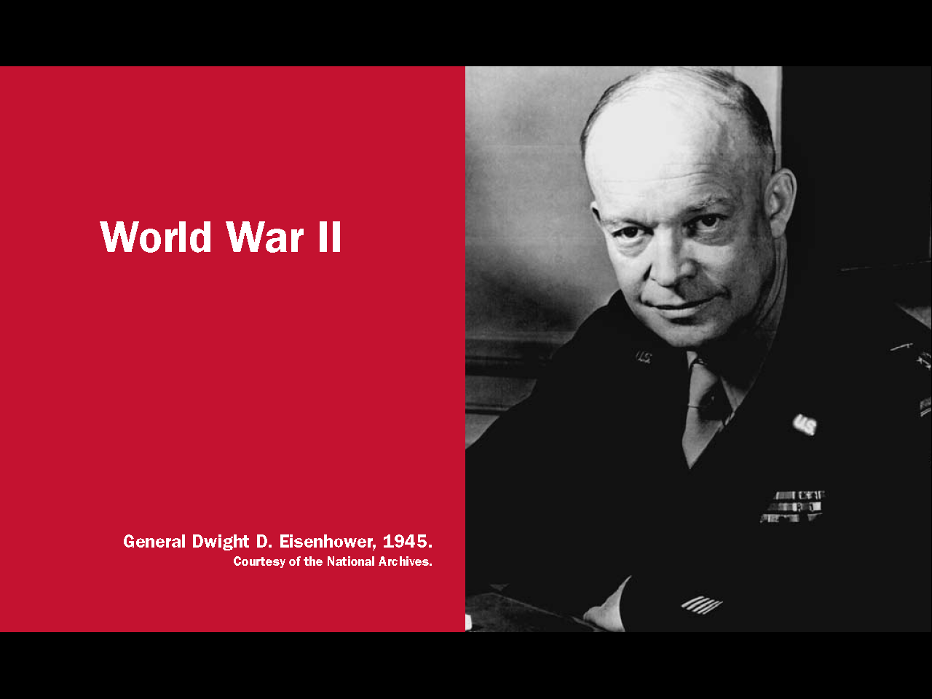
Question # 82

Slide 14
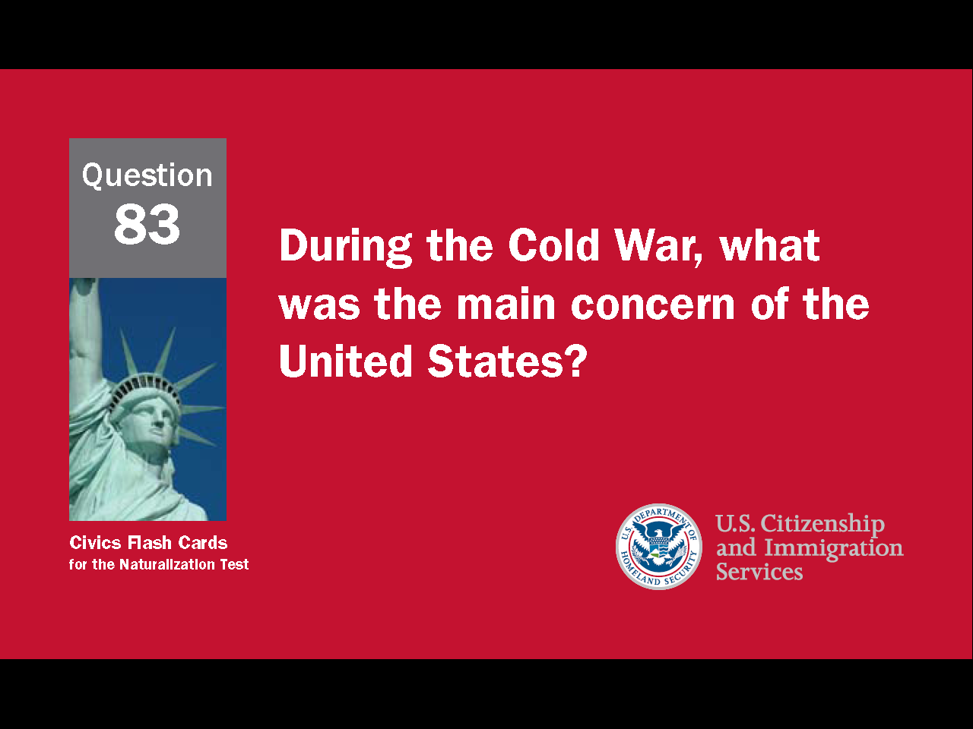

Slide 15

Question # 83

Slide 16
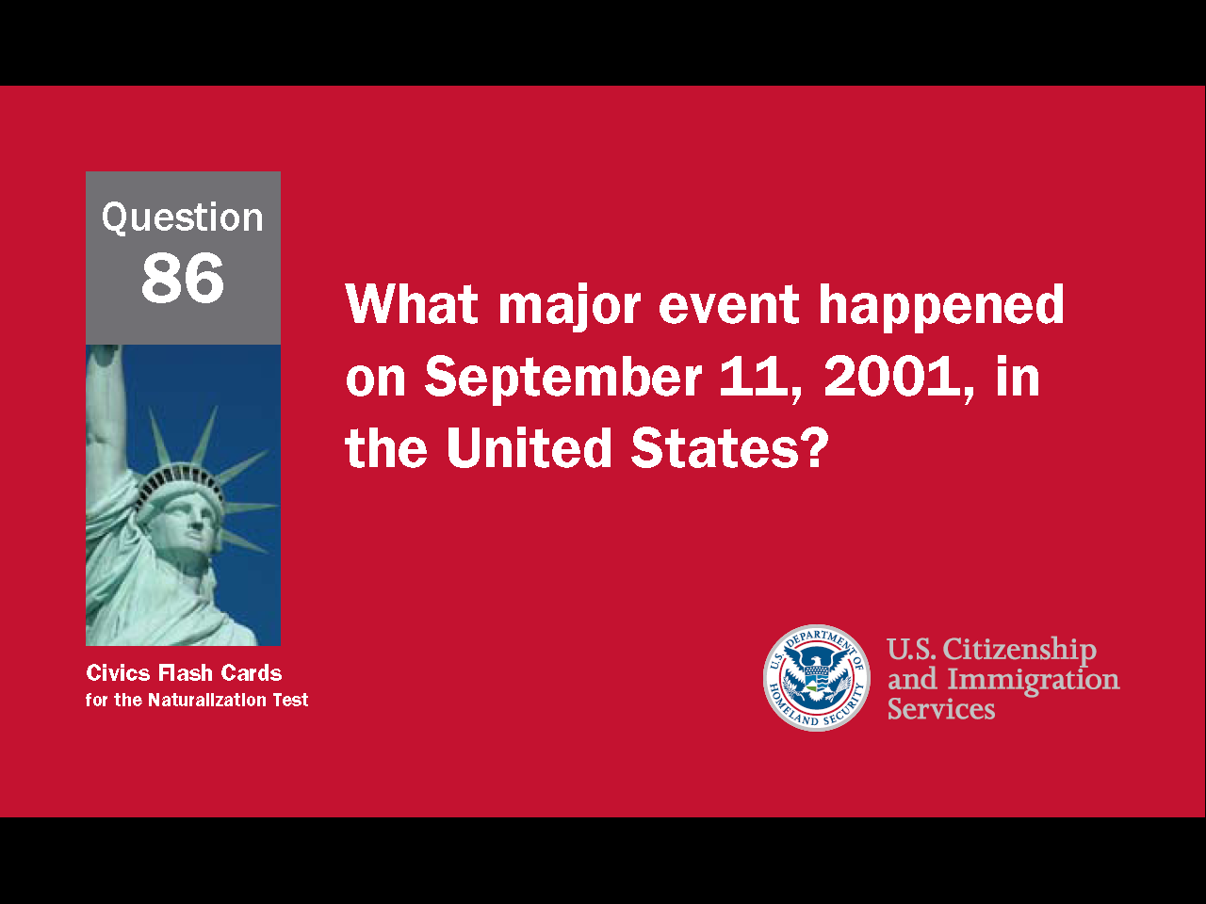

Slide 17

Question # 86

